Slide 1

Green University of Bangladesh
Department of Computer Science and Engineering (CSE)
Faculty of Sciences and Engineering
Semester: Spring, Year: 2022, B.Sc. in CSE (DAY)
LAB REPORT NO # 03
Course Title: Structured Programming Lab
Course Code: CSE 104 Section: CSE 213 - DB (PC)
Lab Experiment Name(s):
Making Logical Decisions in C Language.
Student Details
Name | ID
Md. Shahidul Islam Prodhan | 213902017
Lab Date: 19 February 2022
Submission Date: 26 February 2022
Course Teacher’s Name: Md. Solaiman Mia, Assistant Professor.
[For Teacher’s use only: Don’t write anything inside this box]
Lab Report Status
Marks: | Signature:
Comments: | Date:

Slide 2
1. TITLE OF THE LAB EXPERIMENT
Making Logical Decisions in C Language.
2. OBJECTIVES
In the first problem, user have to enter an integer number to check if it is divisible by 5 or 11. For second problem, user input three random integer number and have to find the maximum number among those three numbers. In third problem, user input any alphabet and check whether the letter is a vowel or a consonant. And the last problem, it is a simple mathematical logic where we have to find a year which is a leap year or not from user input.
3. PROCEDURE
Problem 1: To check whether a number is divisible by 5 and 11 or not.
At first write the basic structure of C program. Then inside main function we declare one variable num. We take that variable from user using scanf function. Mathematically, if we divide any number by 5 and 11 and the remainder is 0 then the number will be divisible by both 5 and 11. So, here we can use if function to make that decision. Otherwise, we use else function which tells us that the number we took, is not divisible by 5 and 11.
Problem 2: Finding maximum between three numbers.
At first, we declare three different variables as num1, num2, num3. Then, we use scanf function to take input from user to those variables. We can use if function to decide which one is the maximum number among these three numbers. If, number1 is greater than or equal to number2 and number3 then we can say the number1 is maximum. Thus, we can use if function for other two numbers (number1 & number2) and make decision to find the maximum number.
Problem 3: Input any alphabet and check whether it is vowel or consonant (Using the switch statement).
This problem is a bit different from others, because here we used the switch statement. The switch statement in C is an alternate to if-else-if ladder statement. Here, we can define various statements in the multiple cases for the different values of a single variable. Such as, in case this problem, we use to determine whether an alphabet is vowel or consonant. If any of the input is lowercase a, e, I, o, u or uppercase A, E, I, O,U that will be vowel, otherwise it is a consonant.
Problem 4: To check whether a year is leap year or not.
Firstly, we declare an integer function and put year variable in it. As we know, a year only will be a leap year if it is divisible by 400 and 4 where the remainder will be 0. But, the year will not be a leap year if it is divisible by 100 and the remainder is 0. We can find it with else if function. Otherwise, neither of the cases, the year will not be a leap year which we can make decision by else function.

Slide 3
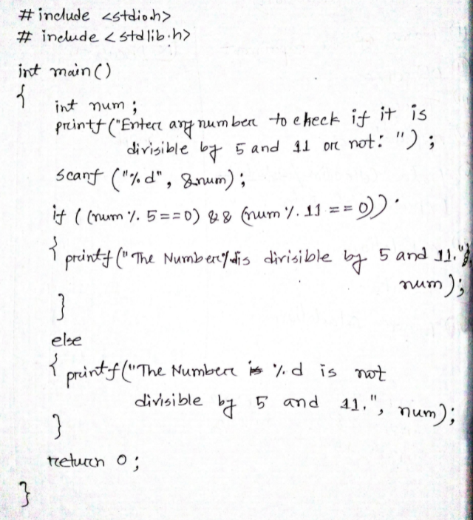
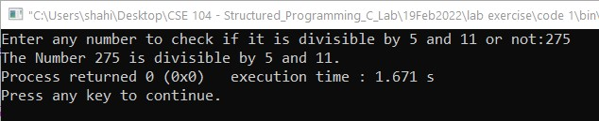
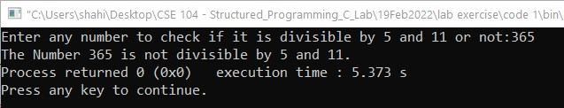
4. IMPLEMENTATION & TEST RESULT
Problem 1: To check whether a number is divisible by 5 and 11 or not.

Slide 4
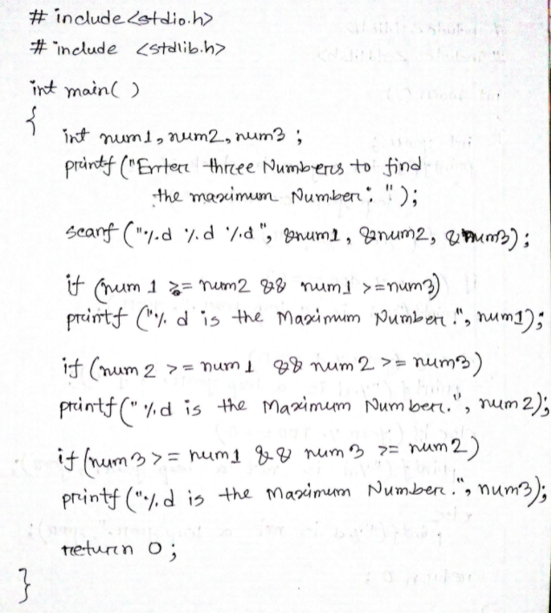
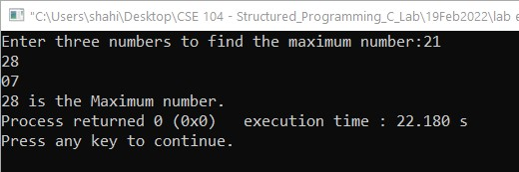
4. IMPLEMENTATION & TEST RESULT
Problem 2: Finding maximum between three numbers.

Slide 5
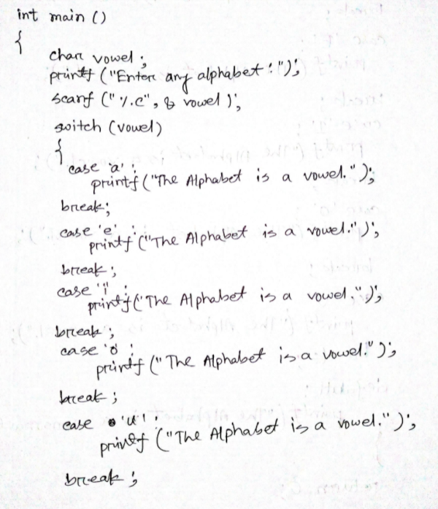
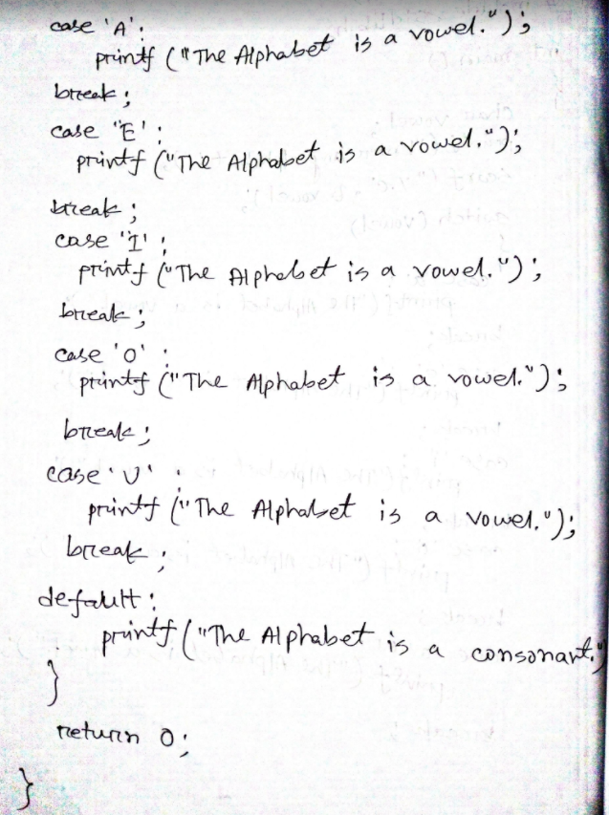
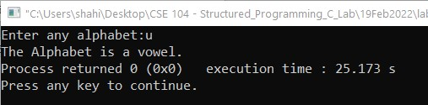
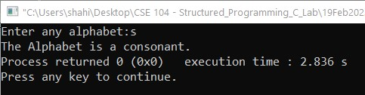
4. IMPLEMENTATION & TEST RESULT
Problem 3: Input any alphabet and check whether it is vowel or consonant (Using the switch statement).

Slide 6
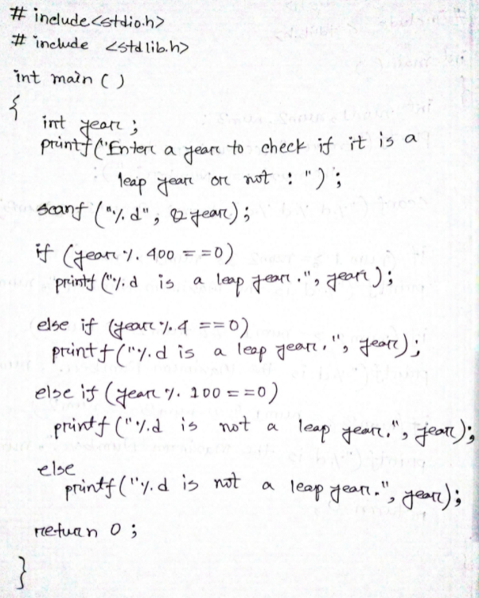
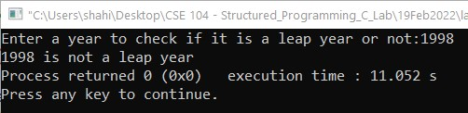
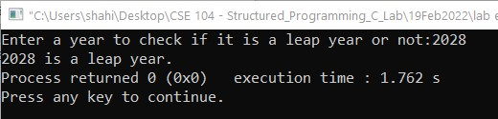
Problem 4: To check whether a year is leap year or not.

Slide 7
6. ANALYSIS AND DISCUSSION
In first problem of determining if a number is divisible by 5 and 11 or not, we used if function and else function. Because we know, if a number is divided by both 5 and 11 and if the remainder is 0, then the number will be divided by both 5 and 11, otherwise it will not. In second problem, the procedure is pretty much similar to the first one, except there is no else function. We can use only if statement to determine whether among three numbers, which one is maximum. Among three different numbers, one has to be a maximum number.
In third problem, we use switch statement which allows us to execute multiple operations for the different possible values of a single variable called switch variable. So, when we take an alphabet as user input the switch kept checking if it is a vowel or not. If it is not vowel, then by default, it will be a consonant. Lastly, the forth problem, it is a combination of if, else and else if function.
We have solved those problems using CodeBlocks IDE and there were no errors occurred. And we can successfully print the output of those problems.
We have faced a little bit difficulty while performing the third problem which is switch related problem showing the wrong results but then we have passed errors and corrected our program and it gives correct result.
5) Solving these 4 problems, we have initially learned the very basics of how to make logical decisions in C language.
7. SUMMARY
From the given experiments, we have learned the very basic implementation of C language in order to make some beginner level logical decisions which introduces us with the following function/statements – if, else, else if, switch.

